Slide 1



Soil Nutrients
Git Hub LINK:- https://github.com/karthick1848/Soil_Nutrians
College Name: GASC HOSUR
Student names: R Karthick
M Venkatachalapathi
M Sivakumar

Slide 2
1.Overview:
This project utilizes Streamlit, a Python-based framework, to create a user-friendly web application for soil nutrient analysis. By assessing critical parameters such as nitrogen, phosphorus, potassium, and soil pH, the application offers actionable recommendations to improve soil fertility and optimize crop health. The tool empowers farmers, agricultural researchers, and enthusiasts with accessible solutions for sustainable farming practices.
Source :
www.freepik.com/

Slide 3
2.Key Objectives:
Develop a simple yet intuitive tool to analyze soil nutrient levels.
Provide actionable insights to enhance soil productivity.
Educate users on the importance of balanced soil nutrient levels for agricultural sustainability.
Problem Statement:
Imbalances in soil nutrients and suboptimal pH levels often lead to reduced agricultural productivity. Without specialized tools or expert guidance, it becomes challenging for farmers to identify and address these deficiencies effectively.

Slide 4
3.Solution:
The project introduces a real-time analysis tool with the following features:
Interactive Interface: Users can input soil nutrient levels (Nitrogen, Phosphorus, Potassium) and soil pH using sliders.
Threshold-Based Recommendations: Logical thresholds categorize nutrient levels into low, adequate, or high, providing tailored advice.
Dynamic Feedback: Recommendations update instantly based on user inputs, enabling quick and informed decision-making.
Source :
www.freepik.com/

Slide 5
Methodology
Framework: Built using Python and Streamlit for web-based deployment.
User Inputs: Soil nutrient levels collected via sliders:
Nitrogen (mg/kg)
Phosphorus (mg/kg)
Potassium (mg/kg)
Soil pH (scale from 4.0 to 9.0)
Threshold Logic:
Low Levels: Suggest fertilizers to improve deficient nutrients.
Adequate Levels: Indicate optimal levels requiring no action.
High Levels: Recommend avoiding over-fertilization.
Source :
www.freepik.com/

Slide 6
Features
Ease of Use: Intuitive interface suitable for farmers and researchers without technical expertise.
Customization: Recommendations based on user-specific inputs and predefined thresholds.
Accessibility: Real-time analysis ensures quick actionable insights to manage soil health.

Slide 7
Deployment
The application is ready for deployment using Streamlit, providing:
Web-based access to farmers, researchers, and agricultural consultants.
Interactive sliders for real-time nutrient assessment and recommendations.
Future Enhancements
Expanded Parameters: Include secondary nutrients (e.g., calcium, magnesium, sulfur) and micronutrients for a holistic soil analysis.
Machine Learning Integration: Incorporate supervised models to predict crop suitability based on soil data.
Historical Data Analysis: Add functionality to store and analyze trends over time for better decision-making.

Slide 8
Results
Example Input:
Nitrogen: 15 mg/kg
Phosphorus: 30 mg/kg
Potassium: 5 mg/kg
pH: 5.5
Output:
Nitrogen Analysis: "Nitrogen level is low. Consider adding nitrogen-based fertilizers."
Phosphorus Analysis: "Phosphorus level is sufficient."
Potassium Analysis: "Potassium level is low. Add potassium-based fertilizers."
pH Analysis: "Soil pH is not ideal. Consider pH adjustment strategies."

Slide 9
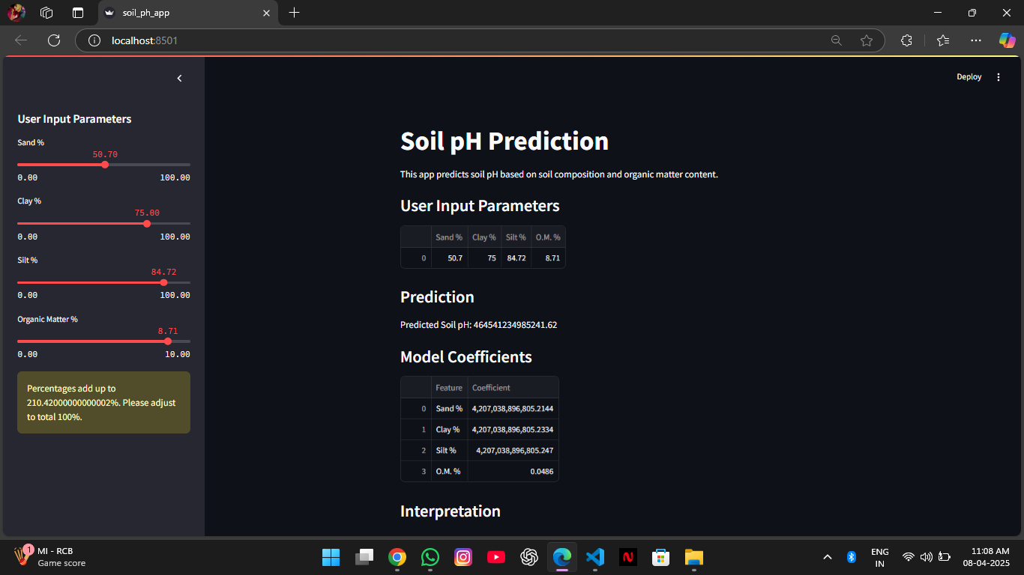
Sample Output

Slide 10

Conclusion
The Soil Nutrient Analysis project effectively addresses the challenge of assessing soil health by offering an intuitive, accessible, and real-time analysis tool. Through the use of Python and Streamlit, the application evaluates critical parameters such as nitrogen, phosphorus, potassium, and soil pH levels. It provides actionable recommendations that are both practical and scientifically sound, empowering farmers and agricultural enthusiasts to make informed decisions about soil management.
Source :
www.freepik.com/

Slide 11
Thank You
Notes:
Thank You !!

